Slide 1
AVAILABLE ELECTRONIC PLATFORMS OF THE BIR IN FILING TAX RETURN
There are two (2) Electronic Platforms available: a) Electronic Filing and Payment Systems
(eFPS) b) Electronic Bureau of Internal Revenue Forms System (eBIRForms)

Slide 2
STEPS ON HOW TO USE eFPS :
1. Signify intention by submitting letter of intent;
2. Enrol to the eFPS facility at the BIR Website for your e-filing;
3. Enrol to the bank for your e-payment

Slide 3
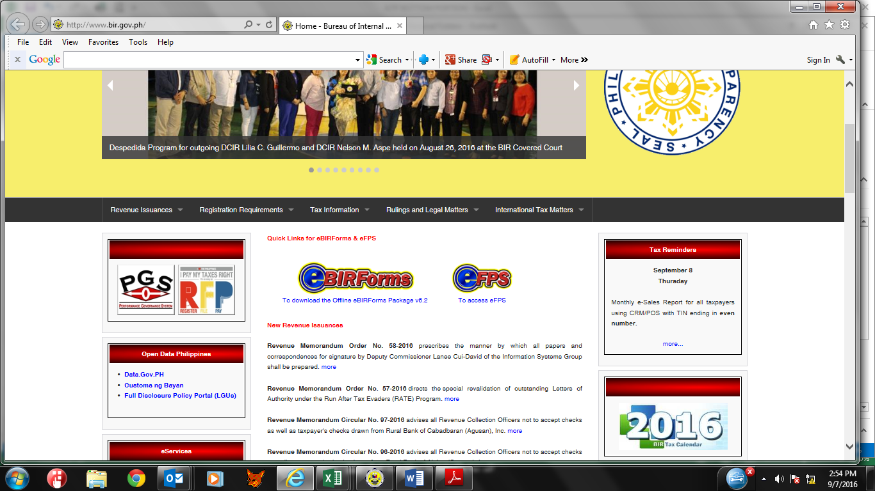
To enrol for eFPS:
Go to the BIR website: www.bir.gov.ph

Slide 4
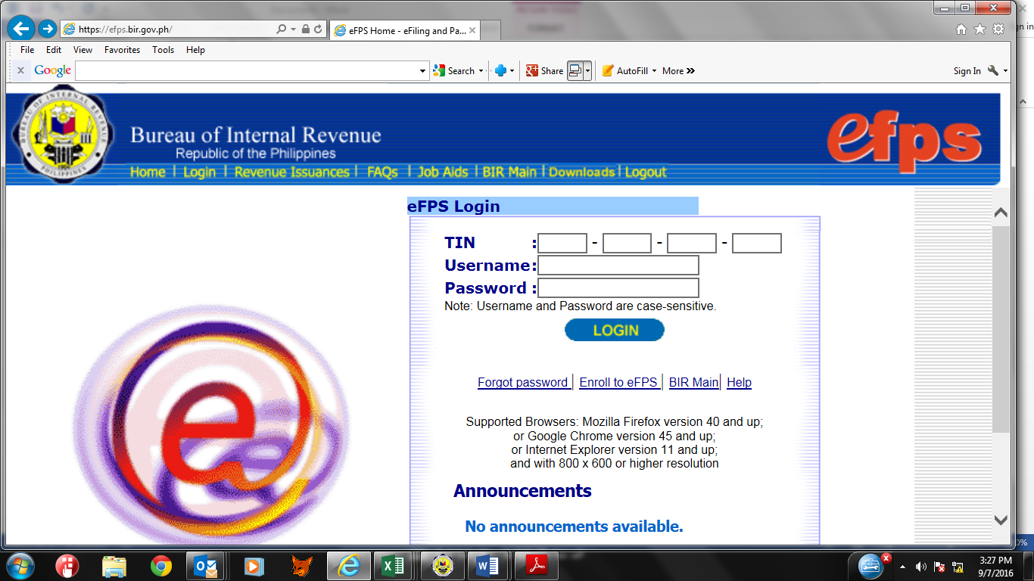
At BIR Webpage, double Click eFPS to display eFPS Portal :

Slide 5
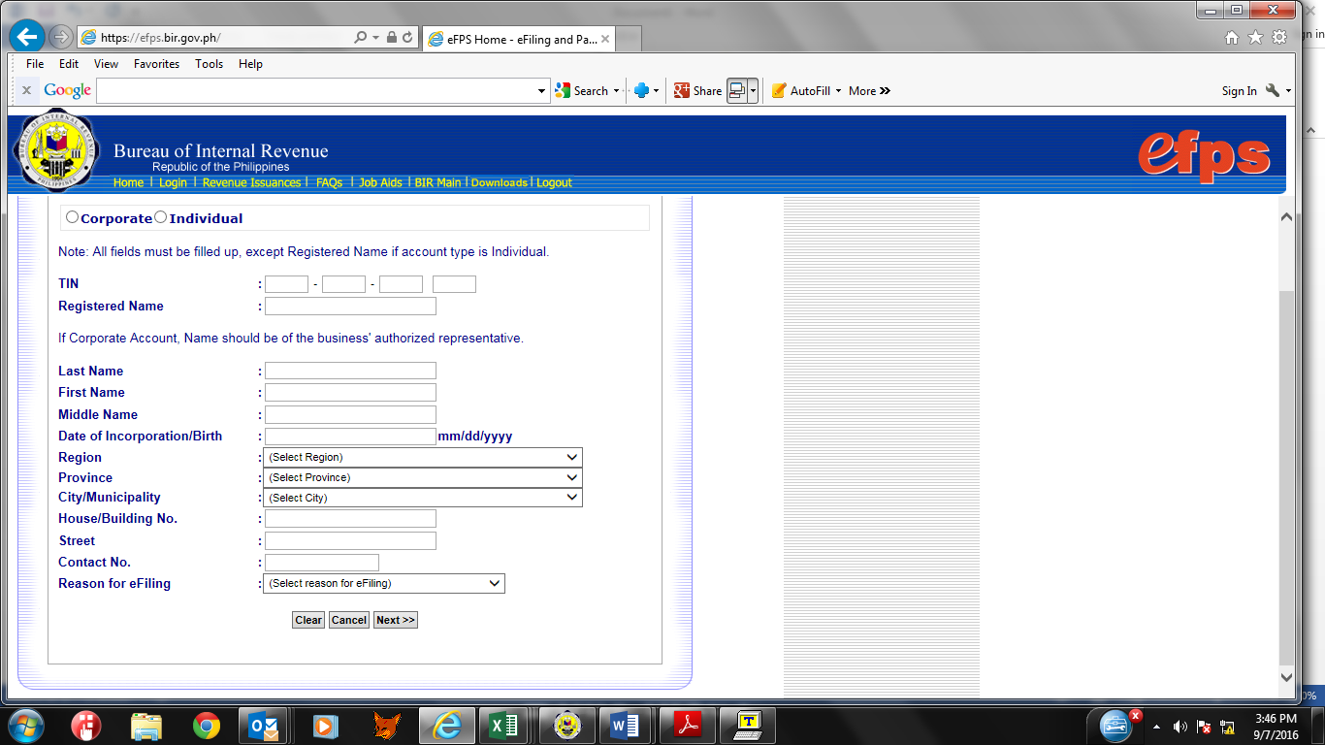
At eFPS Portal; Click “ Enrol to eFPS to accomplish enrolment form :

Slide 6
After accomplishing the form, submit it electronically.

Slide 7
To Download eBIRForms :
Go to BIR Website : www.bir.gov.ph

Slide 8
Double click – eBIRFORM Offline Package
After downloading, install the program to your PC….

