Slide 1

SOCIAL SECURITY SYSTEM
ELECTRONIC, SELF SERVICE & WEB FACILITIES
HIGHLIGHTS
Presented by:
SIMON JUDE Q. OBUT
OIC-Asst. Branch Head
Cagayan de Oro Branch
June 23, 2016

Slide 2

DIAL SSS or INTERACTIVE VOICE RESPONSE SYSTEM (IVRS)
01

Slide 6
SSS WEBSITE
02

Slide 9
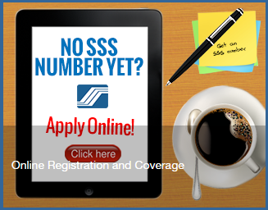
NEW SS NUMBER ISSUANCE
At the dialogue box type: www.sss.gov.ph
At the lower portion of the screen look for this icon and click on the picture.

Slide 10
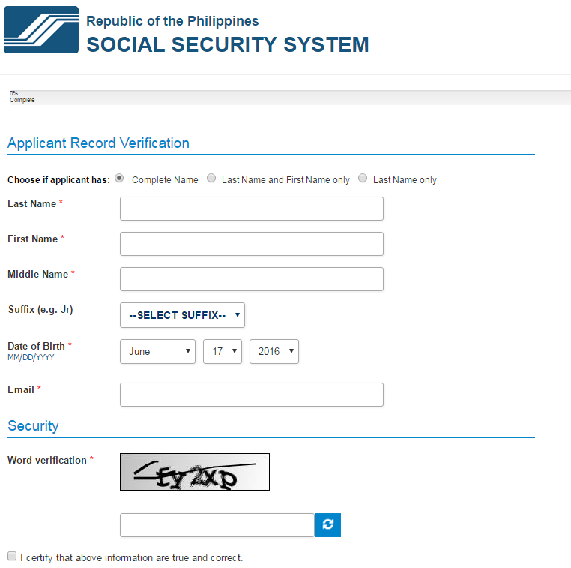

Slide 11
MEMBER SERVICES
Inquiry of member’s profile, contribution, loan
records and repayments.
2. Application for Salary Loan (for self-employed/
voluntary members)
3. Application for Salary Loan (for members with
web-registered employers)
4. Application for Technical Retirement (for members
with no minor children at age 65)

Slide 12
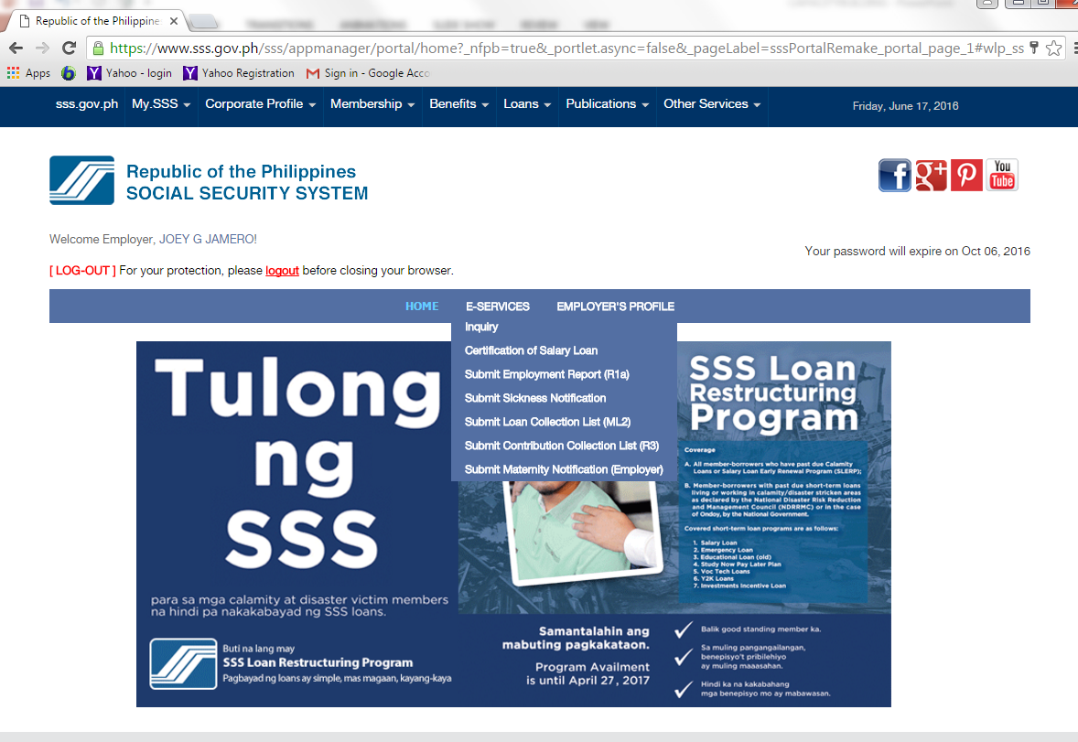
EMPLOYER SERVICES

Slide 13
EMPLOYER SERVICES
Confirmation of employee’s salary loan application.
Submit employment record (SS Form R-1a)
Submit employee’s Sickness/Maternity Notification
Submit Contribution Collection List (R3)
Submit Loan Repayments Collection List (ML2)

Slide 14
SELF-SERVICE INFORMATION TERMINALS (SSIT)
03

Slide 17
This facility can use both the old SSS ID and the new UMID card

Slide 26
ENHANCED TEXT-SSS
04

Slide 38

End of presentation. Thank you.

