Slide 1
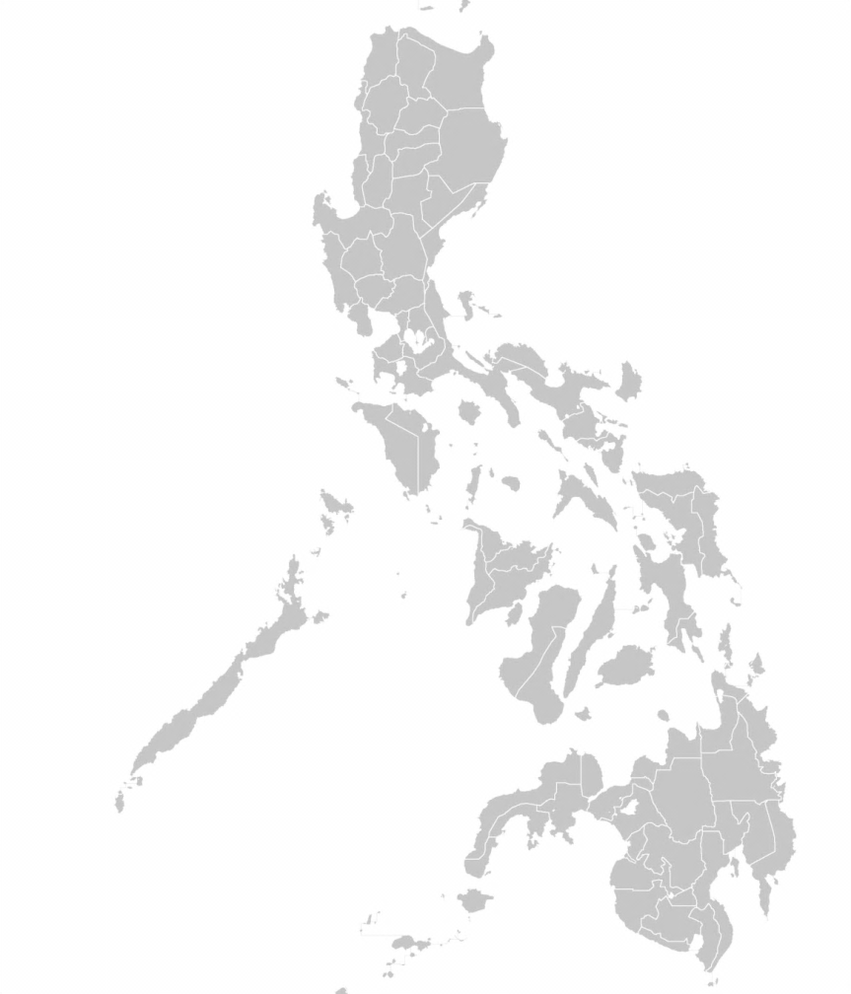
F O R U M
NCC CAPACITY
BUILDING PROGRAM
“Discovering Government E-Service”
14 May 2014, Wednesday
8:30 AM - 4:00 PM
U.P. Ayala Land Techno Hub
Don Mariano Ave., Quezon City

Slide 2
NCC CAPACITY BUILDING PROGRAM
“Discovering Government E-Service”
F O R U M
14 May 2014  8:30 AM - 4:00 PM
U.P. Ayala Land Techno Hub
Don Mariano Ave., Quezon City
P R O G R A M M E
08:30 - 9:00 am | REGISTRATION
09:00 - 09:30 | Invocation National Anthem Acknowledgement of Participants
09:30 - 09:50 | WELCOME REMARKS MR. VIRGILIO P. FULGENCIO Executive Director, CIC-NIMTC Director for Operations (Public Sector), NCC
09:50 - 10:10 | REFRESHMENTS
10:10 - 11:00 | ELECTRONIC DISBURSEMENT & COLLECTION PLATFORM MR. REYNALDO M. MALAYA Vice-President - Fund Management Group PAG-IBIG
11:00 am - 12:00 nn | ELECTRONIC FILING & E-PAYMENT SYSTEM MS. MARIVIC A. GALBAN Chief, Taxpayer Service Program & Monitoring Division Bureau of Internal Revenue
12:00 nn - 01:00 pm | LUNCH
01:00 - 02:00 | E-SERVICES MR. CHRISTIAN MARLO ASPAREN/ MS. MYLA BUEÑO Philhealth
02:00 - 03:00 | ONLINE APPLICATION
03:00 - 03:30 | REFRESHMENTS
03:30 - 04:00 | CLOSING

