Slide 1

Capacity Building Program for e-Services
“Doing Business Made Easier”
Presented by: Alan Gene O. Padilla, MPA, CESO V, CSEE
Social Security System
02 September 2016

Slide 2
DOING BUSINESS WITH WHOM
  Individual Members - 34,246,510
  Pensioners - 2,035,009
  Employers - 920,498
  Partners

Slide 3
DOING WHAT BUSINESS
Registration and Coverage
Collection of Contribution and Loan Payments
Processing and Disbursement of Benefits
Processing and Disbursement of Loans

Slide 4
DOING BUSINESS WHERE
Local Branches
  National Capital Region - 62
  Luzon - 121
  Visayas - 43
  Mindanao - 44
Foreign Office - 22
Online

Slide 5
HOW DO WE CONDUCT BUSINESS: e-Services
Member Services Facilities
SSS Electronic Collection
SSS Electronic Disbursement

Slide 6
SSS Member Services
Facilities

Slide 7
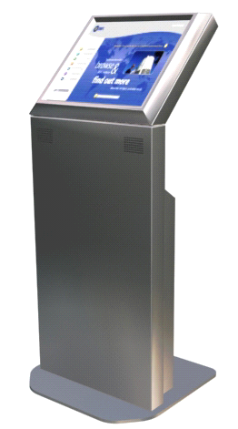
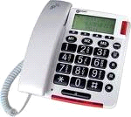
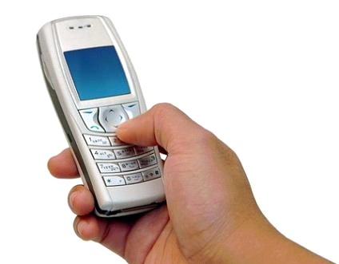
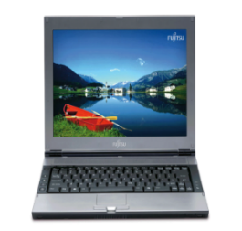

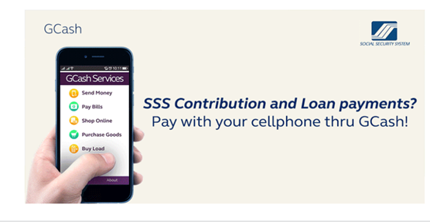
Self-service Facilities
SSIT
IVRS
(Interactive Voice
Response System)
Self-Service
Information
Terminals
917-7777
TEXT SSS & TEXT BLAST FACILITY
SSS WEBSITE
www.sss.gov.ph
PAYMENT
VIA GCash

Slide 8
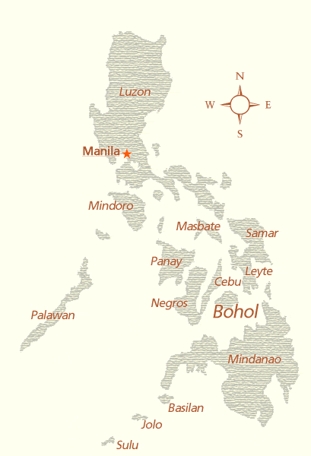


DIAL-SSS or INTERACTIVE VOICE RESPONSE SYSTEM (IVRS)
An automated telephone assistance service for members that responds to inquiries on contributions, benefit claims, salary loans information and eligibility requirements.
Notes:
8
8

Slide 9
IVRS Operation
24 x 7, Call 917-7777
(Toll-free for Globe subscribers only)
The access numbers for the following areas:
Baguio City - 446-5902
Tarlac City - 982-8739
NCR - 917-7777
San Pablo City - 562-9289
Naga City - 472-7776
Cebu City - 253-0690
Bacolod City - 433-9476
Cagayan De Oro City - 727-707
Davao City - 227-7234
Zamboanga City - 992-2014

Slide 10
IVRS Operation – Available Services
Records Inquiry *
  Contributions
  Salary loans
  Benefits
  Fax request
Request to speak to SSS Member Service Officer
* Requires entry of SS Number and Date of Birth

Slide 11
Self-service Facilities
SSIT
IVRS
(Interactive Voice
Response System)
Self-Service
Information
Terminals
917-7777
TEXT SSS & TEXT BLAST FACILITY
SSS WEBSITE
www.sss.gov.ph
PAYMENT
VIA GCash

Slide 12
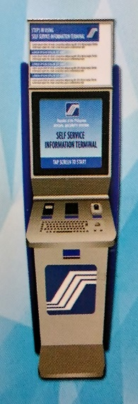
SELF-SERVICE INFORMATION TERMINAL (SSIT)
The SSS ‘kiosk’ allows access to SSS Application systems with the use of SS Card or UMID Card.

Slide 13
SSIT – Available Services
Online Inquiry :
  Contributions
  Loans
  Benefits
  ID information
Transactions :
  Salary loan
  Maternity Notification
  SSS Web registration
  Technical Retirement application
  Annual Confirmation of
  Pensioners (ACOP)
  Change of contact information
Reference to SSS Citizens Charter
Submit feedback and concerns

Slide 14
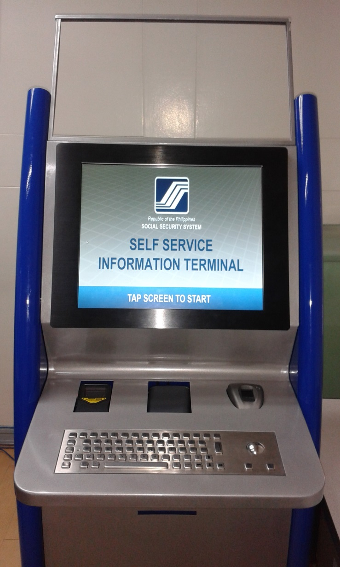
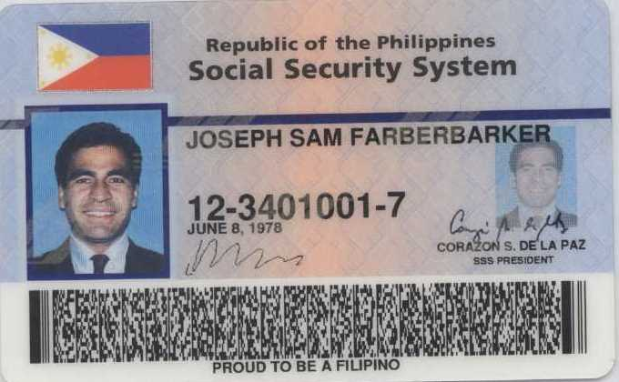
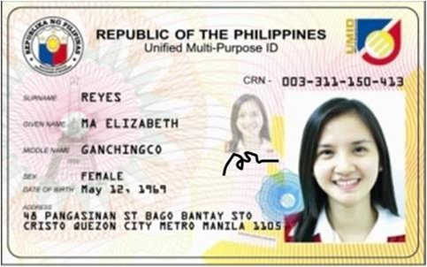
SSIT – How to Use
Requires scanning of the
SSS ID card or the UMID card
& fingerprint matching
UMID CARD
SS ID CARD
FP SCANNER
PRINTER

Slide 15
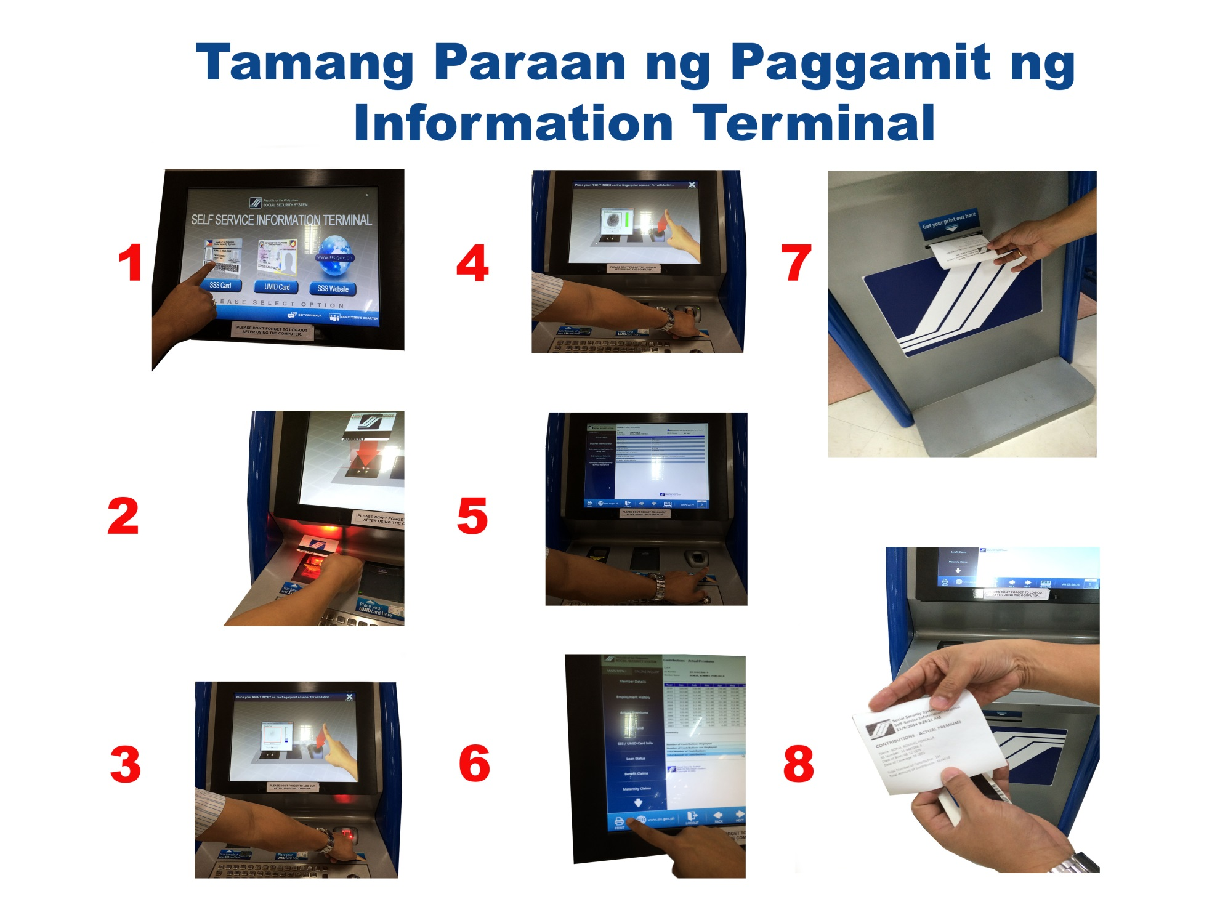
SSIT – How to Use

Slide 16
Self-service Facilities
SSIT
IVRS
(Interactive Voice
Response System)
Self-Service
Information
Terminals
917-7777
TEXT SSS & TEXT BLAST FACILITY
SSS WEBSITE
www.sss.gov.ph
PAYMENT
VIA GCash

Slide 17

ENHANCED TEXT-SSS
Enables SSS members to obtain membership information (contribution record, loan application status and loan balance) and to receive answers to text queries through mobile phone units.
(SERVICE WAS LAUNCHED IN FEB. 2010)
Notes:
17
17

Slide 18

Text blast facility (TBF)
TBF is A Short-Message Service (SMS) to provide SSS information to members and employers on their record and SSS announcements on new programs and projects.
Notes:
18

Slide 19
Self-service Facilities - Text-SSS
Available inquires :
  Contributions*
  Salary loans*
  Claim status*
  Submission of concerns or feedback
  Location of SSS branch offices
  Required documents
  *Requires registration and PIN
  Text fees 2.50 Globe & Smart, 2.00 Sun

Slide 20
Text-SSS Registration & PIN Reset
1. To Register key-in:
SSS REG <SS No> <DATE OF BIRTH mm/dd/yy>
Send to 2600
Example :
SSS REG 0712345689 10/18/77 - Send to 2600
2. To Reset PIN key-in
SSS RESET <SSNO> <DATE OF BIRTH>
send to 2600
Example :
SSS RESET 0712345689 10/18/77 - Send to 2600

Slide 21
Text-SSS - Inquiry
3. Contributions key In:
SSS CONTRIB <SSNO> <PIN> send to 2600
4. Loan Status key-in:
SSS LOANSTAT <SSNO> <PIN> send to 2600
5. Loan Balance key-in:
SSS LOANBAL <SSNO> <PIN> send to 2600

Slide 22
Text-SSS Services
6) To check status of claim – key-in
SSS STATUS Sickness <SS Number> <PIN>
SSS STATUS Maternity <SS Number> <PIN>
SSS STATUS ECMed <SS Number> <PIN>
SSS STATUS Disability <SS Number> <PIN>
SSS STATUS Retirement <SS Number> <PIN>
SSS STATUS Death <SS Number> <PIN>
SSS STATUS Funeral <SS Number> <PIN>
SEND TO 2600

Slide 23
Text-SSS Services
7) To send feedback: **
Key In:
SSS feedback <SS Number> <concerns>
Ex. SSS feedback 0734567890 contri not posted
8) To know the nearest SSS Branch:**
Key In:
SSS BRANCH <city> or <postal code>
Ex. SSS BRANCH MANILA
Ex. SSS BRANCH 1100
** NO REGISTRATION REQUIRED
:
Send
to 2600

Slide 24
TEXT – BLAST
Broadcasting information through SMS; launched on 29 June 2015.
MEMBER’S CONTRIBUTIONS
LOANS GRANTING
ACOP
SICKNESS/MATERNITY
DISABILITY / RETIREMENT
PROMOTIONS OF NEW PROGRAMS
INFORMATION DRIVE

Slide 25
Self-service Facilities
SSIT
IVRS
(Interactive Voice
Response System)
Self-Service
Information
Terminals
917-7777
TEXT SSS & TEXT BLAST FACILITY
SSS WEBSITE
www.sss.gov.ph
PAYMENT
VIA GCash

Slide 26
ENHANCED SSS WEBSITE
Aims to provide a secure, convenient access of information to SSS Members and Employers for viewing and printing their records, downloading forms and submitting applications/reports online.

Slide 27

SSS Web Registration

Slide 28
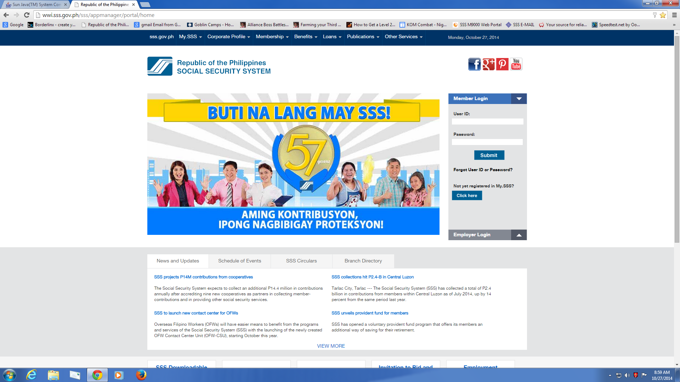
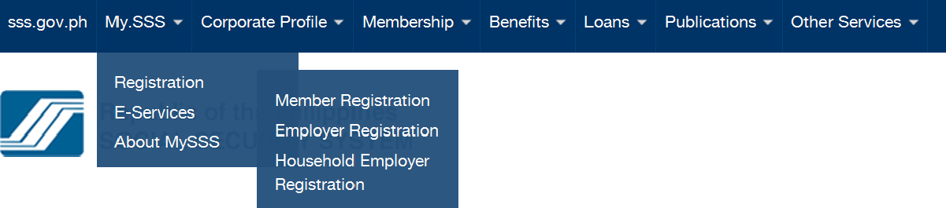

Slide 29
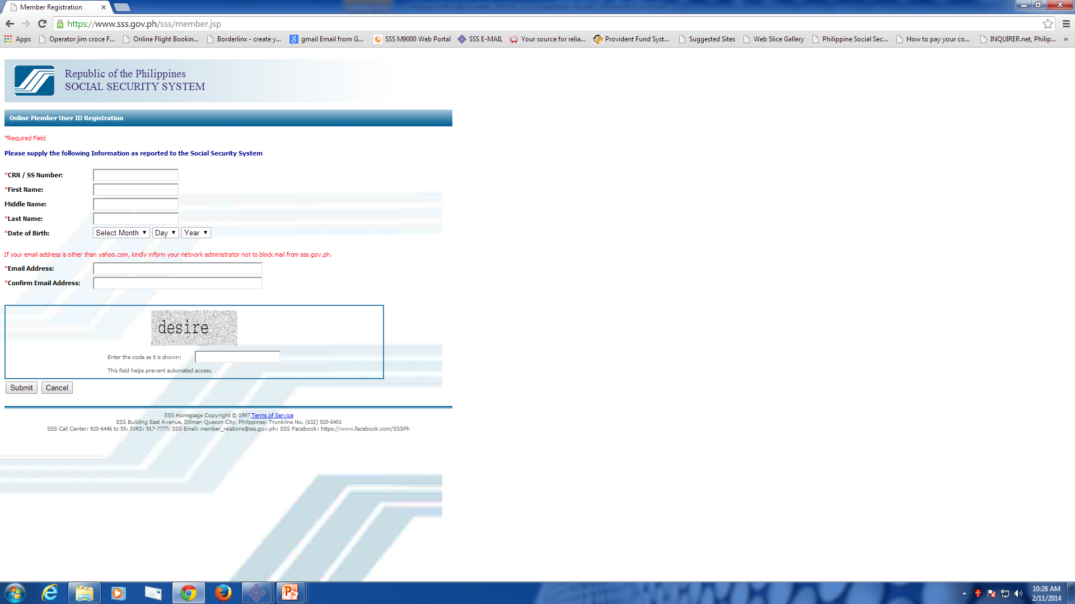
SSS Web Registration – Member
Step 1 – requires entry of the ff :
  SS Number
  Name (First, Last, Middle –optional)
  Date of birth
  Email address
  CAPTCHA code
Step 2 – Access registration link in email

Slide 30
SSS Web Registration – Member
Step 3 – Entry of additional information :
  Mother’s maiden name
  Address
  Contact number
  Preferred Userid & Password
  If pensioner – Savings account no/check no
  If employed – Employer ID number
  If Self-employed/voluntary – Receipt number
  Agree to Terms & Conditions
Step 4 – Access Userid/Password in email

Slide 31
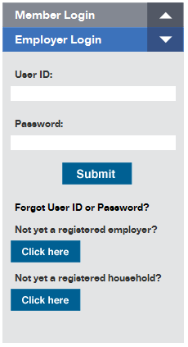
SSS Web Registration – Employer

Slide 32
SSS Web Registration – Employer
Step 1 – Entry of basic information :
  Employer ID number
  Address (employers only)
  Email address of Company/Household-employer
  Preferred Userid/password
  Landline & mobile numbers (Household-employers only)
  CAPTCHA code

Slide 33
SSS Web Registration – Employer
Step 2 – Access registration link in email
Step 3 – Entry of Employer Authorized Signatory information :
  SS number
  Name (First, Last, Middle-optional)
  Email address
  Preferred Userid/password
  Agree to Terms & Conditions

Slide 34
SSS Web Registration – Employer
Step 4 – Approval of Employer Signatory
Step 5 – Receipt of email from SSS (successful or failed registration)

Slide 35
SSS Web – Inquiry & Transactions

Slide 36
SSS Web Services - Member
Online inquiry:
  Contributions
  Benefits
  Loans
  Eligibility inquiry to benefits & loans
  ID information
  Documentary requirements

Slide 37
SSS Web Services - Member
Online transactions :
  Apply for SS Number
  Submit Salary Loans
  Submit maternity notification
  Submit Technical Retirement Application
  Request for branch office appointment

Slide 38
SSS Web Services - Employer
Online inquiry:
  SSS Servicing Branch
  Contribution & Loan payments
  Sickness & Maternity claims
  Loans billing

Slide 39
SSS Web Services - Employer
Online transactions :
  Submit contribution collection list (R3)
  Submit loans collection list (ML2)
  Submit list of new employees (R1A)
  Submit maternity notification of employees
  Certify Salary Loan application of employees
  Submit sickness notification of employees
  Download Contribution Billing

Slide 40
Self-service Facilities
SSIT
IVRS
(Interactive Voice
Response System)
Self-Service
Information
Terminals
917-7777
TEXT SSS & TEXT BLAST FACILITY
SSS WEBSITE
www.sss.gov.ph
PAYMENT
VIA GCash

Slide 41
Contribution and loan payments via G-cASH
GCash is an alternative payment facility for SS contribution and short and long-term loan amortization for Globe Telecom subscribed members.
Notes:
41

Slide 42
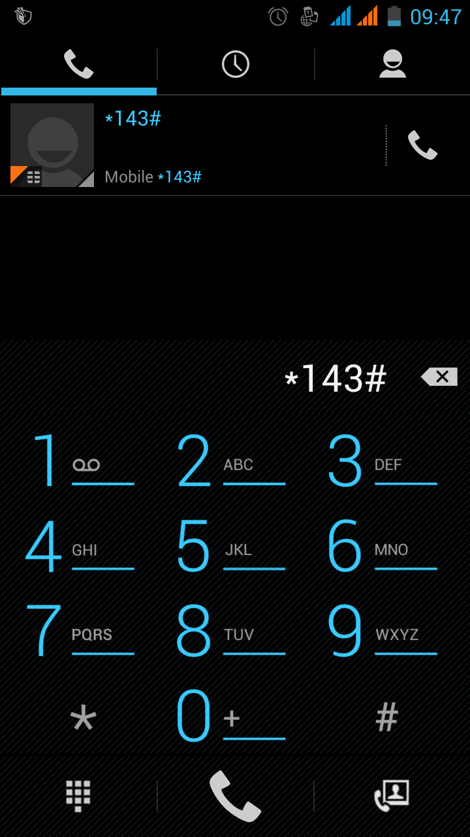
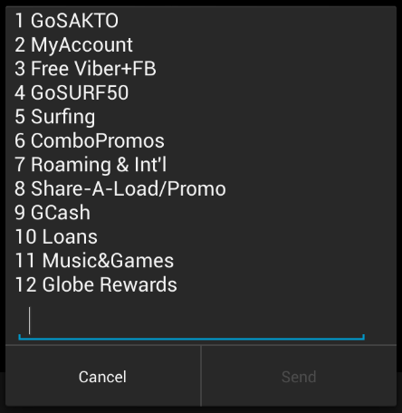
How to register to GCASH
Dial *143#
Select “9”(GCASH)

Slide 43
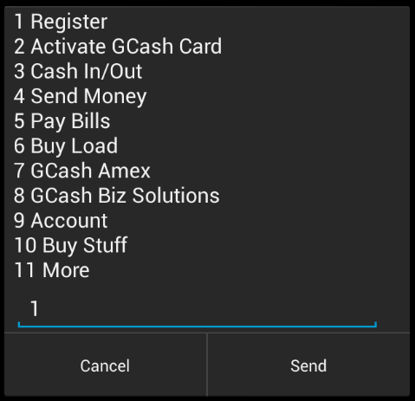
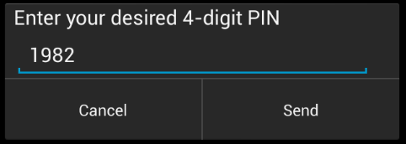
How to register to GCASH
Select “1” (Register)
Enter 4-digit PIN

Slide 44
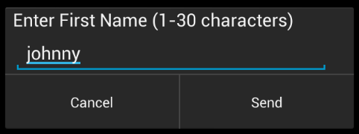
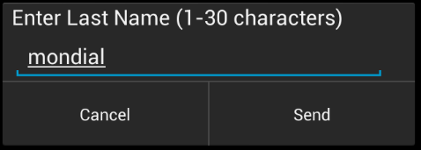
How to register to GCASH
Enter ‘First Name’
Enter ‘Last Name’

Slide 45
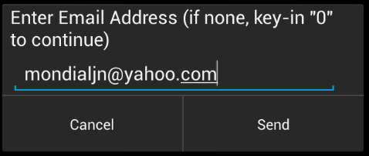
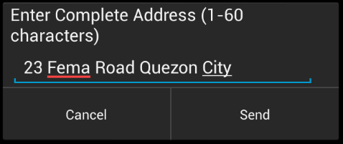
How to register to GCASH
Enter ‘Complete Address’
Enter ‘Email Address’

Slide 46
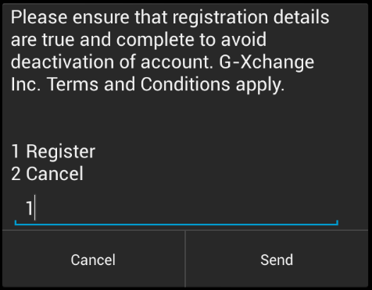
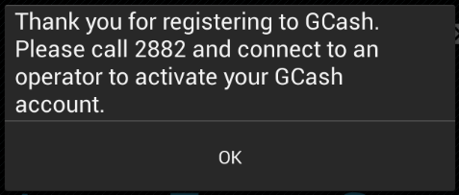
How to register to GCASH
A prompt will be received to activate GCASH account.
Confirm Registration

Slide 47
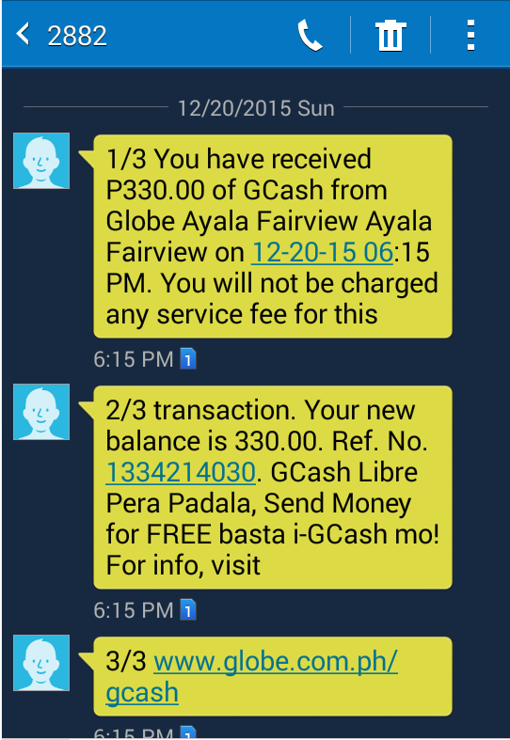
After activating the account and loading the GCASH wallet an SMS prompt will be sent to the member.

Slide 48
Contact Information
For GCash related concerns:
739-2882 – landline (Globe) – NCR only
2882 – mobile phone (free of charge - Globe)
Email – www.globe.com.ph
SSS related concerns:
920-6446 to 55 – SSS hotline
180010CALLSSS (1800102255777) – SSS Toll Free number
Email – member_relations@sss.gov.ph
For SSS online transactions concerns, you may also contact us through contact information indicated below:
Email – onlineserviceassistance@sss.gov.ph
9206401 locals 5240,6066,6082,6447 and 6091 to 95

Slide 49

SSS eCollection

Slide 50
SSS eCollection
Electronic submission of collection reports of Employers
  Contribution Report
  Loan Repayment Report
Electronic submission of collection reports by authorized service providers
  Banks
  Non-Banks
Increase compliance in payment/reporting
Attain Recording efficiency

Slide 51
SSS eCollection Scheme
EMPLOYER
  Contributions Collection List (R3)
  Loan Repayments Collection List (ML-2)
  Contribution/Loan Payments
Facilities:
SSS Branch
Internet - SSS Website
Electronic Data Interchange Providers
Service Providers (Banks/Non-Banks)
New Contribution Collection System

Slide 52
SSS eCollection Scheme
INDIVIDUAL MEMBERS
  Contribution Payments (RS5)
  Loan Repayments (ML-1)
Facilities:
SSS Automated Tellering System
Accredited Payment Centers - BayadCenters, SM, iRemit, Ventaja, PNB Foreign
Internet
Auto-Debit Arrangement with banks
Tie-up with LGUs and Government Agencies
Gcash/Smart

Slide 53
Employer Electronic Transaction Facilities

Slide 54
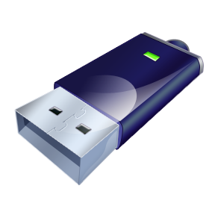


1. Employer Submission at SSS Branch
Facilities
  Electronic R3 Submission System
  Electronic Loans Collection List Submission System
Media
  Portable Storage Media
    USB Drive, Flash Disk
    CD/DVD

Slide 55
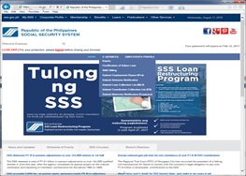
2. Employer Submission Thru SSS Website
Access SSS Portal
SSS Website
  www.sss.gov.ph
1
Employer logs-in to My.SSS
2
Access Collection List submission module
3
Update or upload collection list
4
SSS validates list and informs member of result
Process:

Slide 56





3. Employer Submission Thru SSSNet (EDI)
Process:
1
Employer submits Collection List to Provider and issues Payment Order (PO) to Employer Depository Bank (EDB)
2
EDB debits employer account and transmit this to SSS depository bank
3
SSSNet Provider submits Collection List, Debit Advice, Credit Advice to SSS
4
SSS validates DA, Collection list and informs employer of result

Slide 57
4. Employer Submission Thru Collection Service Provider (Bank or Non-bank)
Process:
1
Employer/individual member pays contribution or loan at authorized Service Provider
2
Service Provider transmits collection file to SSS using Virtual Private Network connection
3
SSS Validates collection file, send acknowledgment file to Service Provider
4
SSS Posts valid collection files

Slide 58

5. Employer Contribution Collection System
To ensure that payment of contributions made by an employer reconciles with the detailed list of contributions of his/her employees
To ensure that contributions are paid by the employer before these are posted to the employees’ record
To ensure that payments are immediately recorded in the employer’s database and contributions of each employee are likewise recorded in the employees’ database
To ensure that remitted contributions are properly and accurately posted to the right members, i.e., does not result to unpostable items/belong to another person

Slide 59
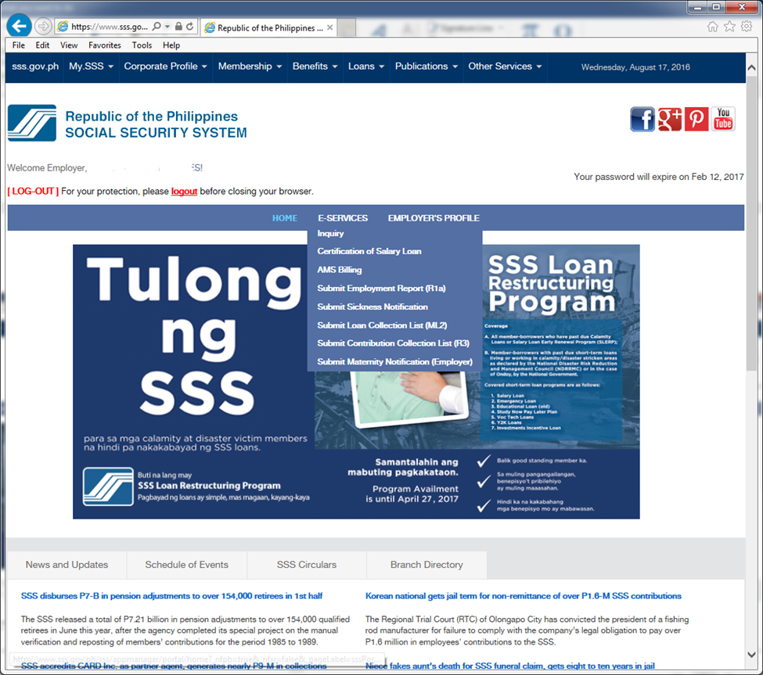
Procedural Flow
Employer Accesses My.SSS Account
ER logs-in to its My.SSS Account (Proceed with website registration process if not yet enrolled)
ER Builds-up Employee List
Buildup or update the Employer Collection List
ER Payment
Proceed to SSS Branch (payment thru banks being worked on)
Clicks ‘Submit’ button once done with their Collection List; and
Generate and print the Contribution Statement
Accesses the Accounts Management System from the menu option
Present Contribution Statement
Teller processes payment and validates Contribution Statement
SSS Posting System
Retrieves payments from Cash Collection database
Posts to employer payment ledger
Retrieves confirmed Contribution list from AMS database and posts to individual record

Slide 60
Individual Member Transaction Facilities

Slide 61
1. SSS Automated Tellering System
Process:
1
Member pays at SSS branch
2
SSS branch validates Loan or contribution payment
3
Branch Transfers payment records to main servers
4
Collection System segregates and transmits records to specific systems for posting

Slide 62







2. Payment Centers
Payment Centers
1
Member pays at accredited payment center
2
Payment Center validates Loan or Contribution Payment file
3
Payment Center submits collection file to SSS and the payment to SSS depository bank
4
SSS validates file, and informs Payment Center of validation result

Slide 63
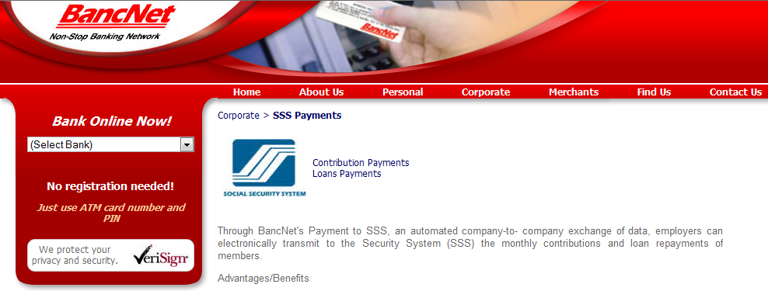
3. Internet Payment
www.bancnetonline.com
1
Member logs-on to BancNet website
2
Clicks on his bank account and selects ‘Payment’ as transaction type
3
Click SSS from the drop-down menu of Billers/ Institutions then fill-out the required fields
4
At end-of-day, BancNet transmits records to SSS for posting

Slide 64
4. Auto-Debit Arrangement System
Process:
1
Member enrolls at SSS branch or at member depository bank and indicate types of payment to debit from account
2
SSS creates monthly billing file and sends to participating bank
3
Bank debits member account, submits collection file to SSS
4
Collection System segregates and transmits records to specific systems for posting

Slide 65
5. Tie-up with Collection Partners (on-going)
Collection Partners:
Local Government Units (LGU)
Government Agencies (GA), i.e. DepEd, MMDA
Informal Sector Group (ISG), i.e. Coops, TODAs, Golf Caddies groups, etc.
Collection of payments from:
Job Order personnel
Self-Employed
Voluntary Members
OFW

Slide 66
6. Gcash
Part of Member Services Presentation

Slide 67
Electronic Disbursement facilities

Slide 68
E-Disbursements General Flow
For Posting
6
Confirmed
F.T. to SSS
Member Accts.
S S S
5
Internet
1
Loans / Benefits
SSS Partner
Banks
EOD
SSS Acct
Balances
2
LOI:
SSS to PFI
1
Extract
2
3
Summary
Payable Records
Confirmed SSS to SSS
F.T.
4
Fund Disbursements
3
Payable Records
LOI:CR To SSS
Member Accts,
DR To SSS Accts
LOI: Pay Members

Slide 69
ELECTRONIC DISBURSEMENTS
Mag-Impok sa Bangko Program for Pensioners: 2.04 million pensioners;
Sickness / Maternity Reimbursement through the Bank;
Initial DDR Benefit Disbursement through the Bank
Salary Loans Proceeds through Citi Bank and Union Bank Cash Card
UMID as ATM (for all disbursements)

Slide 70

End of presentation. Thank you.

Slide 71
End of presentation. Thank you.

