Slide 1

The SSS eGov Services
Presented by:
Philippine Social Security System
99 Month 2016

Slide 2
1. SSS Electronic Collection
2. SSS Electronic Disbursement
3. SSS Member Services Facilities
Topics

Slide 3
Electronic Collection Initiatives

Slide 4
SSS eCollection Project
Objective:
Electronic submission of collection reports of Employers
  Contribution Report
  Loan Repayment Report
Electronic submission of collection reports by authorized service providers
  Banks
  Non-Banks

Slide 5
SSS eCollection Project
Benefits:
Increase compliance in payment/reporting
  Increase collections
  Reduce members’ complaints
Attain Recording efficiency
  Increase accuracy of records
  Eliminate manual work; Simplified/faster preparation
  Faster processing of transactions

Slide 6
SSS eCollection Scheme
Facilities:
SSS Branch
Internet - SSS Website
Electronic Data Interchange Providers
Service Providers (Banks/Non-Banks New Contribution Collection System
1. EMPLOYER
  Contributions Collection List (R3)
  Loan Repayments Collection List (ML-2)
  Contribution/Loan Payments
2. INDIVIDUAL MEMBERS
  Contribution Payments (RS5)
  Loan Repayments (ML-1)
Facilities:
SSS Automated Tellering System
Accredited Payment Centers - BayadCenters, SM, iRemit, Ventaja, PNB Foreign
Internet
Auto-Debit Arrangement with banks
Tie-up with LGUs and Government Agencies
Gcash/Smart

Slide 7
Employer Transaction Facilities

Slide 8
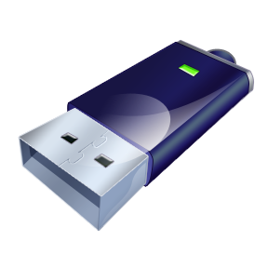

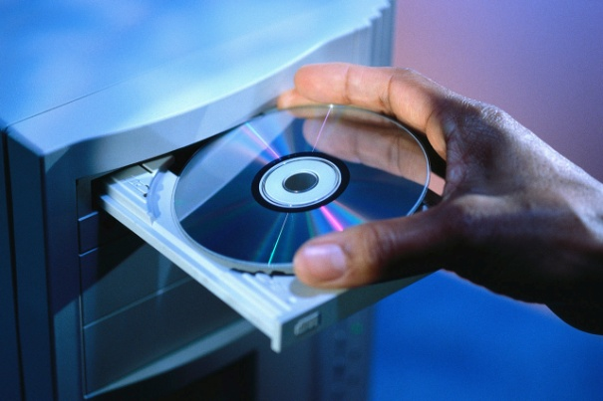
1. Employer Submission at SSS Branch
Facilities
  Electronic R3 Submission System
  Electronic Loans Collection List Submission System
Media
  Portable Storage Media
    USB Drive, Flash Disk
    CD/DVD

Slide 9
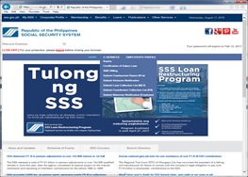
2. Employer Submission Thru SSS Website
Access SSS Portal
SSS Website
  www.sss.gov.ph
1
Employer logs-in to My.SSS
2
Access Collection List submission module
3
Update or upload collection list
4
SSS validates list and informs member of result
Process:

Slide 10





3. Employer Submission Thru SSSNet
Process:
1
Employer submits Collection List to Provider and issues Payment Order (PO) to Employer Depository Bank (EDB)
2
EDB debits employer account and transmit this to SSS depository bank
3
SSSNet Provider submits Collection List, Debit Advice, Credit Advice to SSS
4
SSS validates DA, Collection list and informs employer of result

Slide 11
4. Employer Submission Thru Collection Service Provider (Bank or Non-bank)
Process:
1
Employer/individual member pays contribution or loan at authorized Service Provider
2
Service Provider transmits collection file to SSS using Virtual Private Network connection
3
SSS Validates collection file, send acknowledgment file to Service Provider
4
SSS Posts valid collection files

Slide 12

5. Employer Contribution Collection System
Objectives
To ensure that payment of contributions made by an employer reconciles with the detailed list of contributions of his/her employees
To ensure that contributions are paid by the employer before these are posted to the employees’ record
To ensure that payments are immediately recorded in the employer’s database and contributions of each employee are likewise recorded in the employees’ database
To ensure that remitted contributions are properly and accurately posted to the right members, i.e., does not result to unpostable items/belong to another person

Slide 13
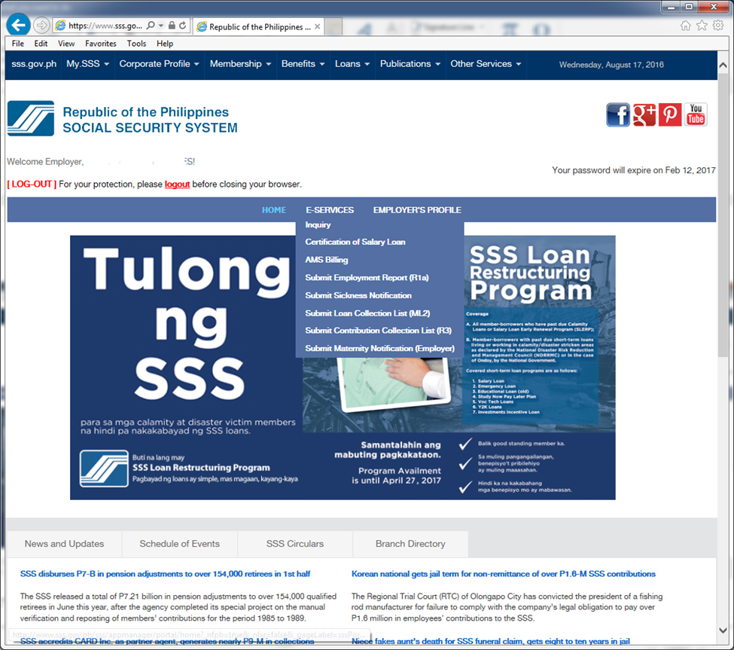
Procedural Flow
Employer Accesses My.SSS Account
ER logs-in to its My.SSS Account (Proceed with website registration process if not yet enrolled)
ER Builds-up Employee List
Buildup or update the Employer Collection List
ER Payment
Proceed to SSS Branch (payment thru banks being worked on)
Clicks ‘Submit’ button once done with their Collection List; and
Generate and print the Contribution Statement
Accesses the Accounts Management System from the menu option
Present Contribution Statement
Teller processes payment and validates Contribution Statement
SSS Posting System
Retrieves payments from Cash Collection database
Posts to employer payment ledger
Retrieves confirmed Contribution list from AMS database and posts to individual record

Slide 14
Individual Member Transaction Facilities

Slide 15
1. SSS Automated Tellering System
Process:
1
Member pays at SSS branch
2
SSS branch validates Loan or contribution payment
3
Branch Transfers payment records to main servers
4
Collection System segregates and transmits records to specific systems for posting

Slide 16







2. Payment Centers
Payment Centers
1
Member pays at accredited payment center
2
Payment Center validates Loan or Contribution Payment file
3
Payment Center submits collection file to SSS and the payment to SSS depository bank
4
SSS validates file, and informs Payment Center of validation result

Slide 17
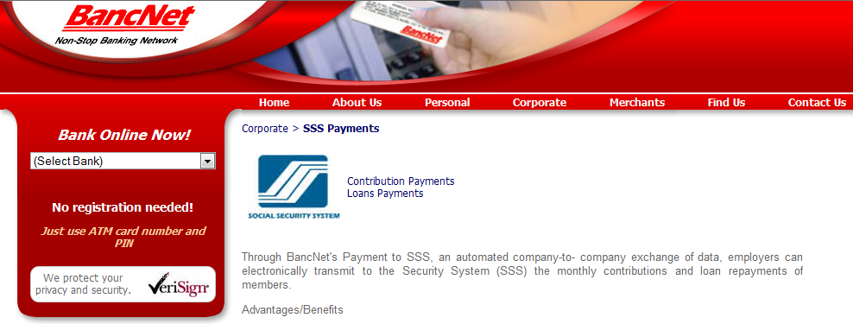
3. Internet Payment
www.bancnetonline.com
1
Member logs-on to BancNet website
2
Clicks on his bank account and selects ‘Payment’ as transaction type
3
Click SSS from the drop-down menu of Billers/ Institutions then fill-out the required fields
4
At end-of-day, BancNet transmits records to SSS for posting

Slide 18
4. Auto-Debit Arrangement System
Process:
1
Member enrolls at SSS branch or at member depository bank and indicate types of payment to debit from account
2
SSS creates monthly billing file and sends to participating bank
3
Bank debits member account, submits collection file to SSS
4
Collection System segregates and transmits records to specific systems for posting

Slide 19
5. Tie-up with Collection Partners (on-going)
Collection Partners:
Local Government Units (LGU)
Government Agencies (GA), i.e. DepEd, MMDA
Informal Sector Group (ISG), i.e. Coops, TODAs, Golf Caddies groups, etc.
Collection of payments from:
Job Order personnel
Self-Employed
Voluntary Members
OFW

Slide 20
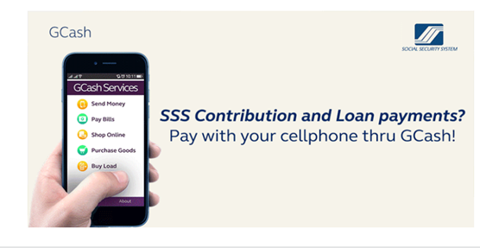
6. Contribution and Loan Payments via GCash
GCash is an alternative payment facility for SS contribution and short and long-term loan amortization for Globe Telecom subscribed members.
Provide collection service to the SSS, which includes the following activities:
Electronic payment data entry and validation;
Confirmation of payment transaction;
Electronic generation, consolidation, validation and uploading of collection data to the SSS; and
Consolidation and monitoring of collection remittances
Notes:
20

Slide 21
Electronic Disbursement facilities

Slide 22
E-Disbursements General Flow
For Posting
6
Confirmed
F.T. to SSS
Member Accts.
S S S
5
Internet
1
Loans / Benefits
SSS Partner
Banks
EOD
SSS Acct
Balances
2
LOI:
SSS to PFI
1
Extract
2
3
Summary
Payable Records
Confirmed SSS to SSS
F.T.
4
Fund Disbursements
3
Payable Records
LOI:CR To SSS
Member Accts,
DR To SSS Accts
LOI: Pay Members

Slide 23
Electronic Disbursements
Mag-Impok sa Bangko Program for Pensioners: 1.9 million pensioners;
Sickness / Maternity Reimbursement through the Bank;
Initial DDR Benefit Disbursement through the Bank
Salary Loans Proceeds through Citi Bank Cash Card
For implementation: UMID as ATM (for all disbursements)

Slide 24
SSS Member Services Facilities

Slide 25


Manned Service Facilities
CALL CENTER (24 X 5)
920-6446 to 55
or 917-7777 (toll-free for Globe subscribers)
POSTAL MAIL
Member Relations Department
2/F SSS Main Office Buidling
East Avenue, Diliman, Q.C. 1100

Slide 26


Manned Service Facilities
Via email & social media sites
Email : member_relations@sss.gov.ph
http://www.facebook.com/sssgov
http://www.youtube.com/user/MySSSPhilippines
https://plus.google.com/108094303314551604810/posts
http://www.pinterest.com/phlsss/

Slide 27
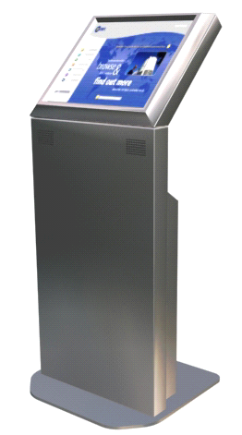
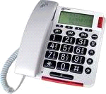
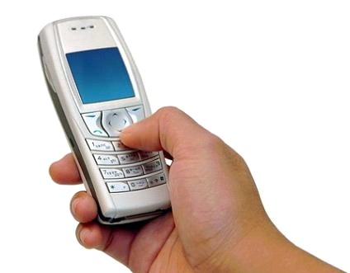
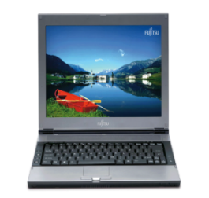

Self-service Facilities
SSIT
IVRS
(Interactive Voice
Response System)
Self-Service
Information
Terminals
917-7777
TEXT SSS & TEXT BLAST FACILITY
SSS WEBSITE
www.sss.gov.ph
PAYMENT
VIA GCash

Slide 28
Note to Presentor: The following are detailed slides on Member Services that may be presented as needed, depending on the audience composition. To do so, unhide the slides.

Slide 29
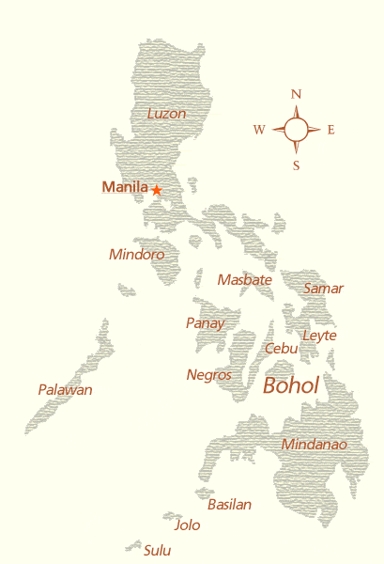


DIAL-SSS or INTERACTIVE VOICE RESPONSE SYSTEM (IVRS)
An automated telephone assistance service for members that responds to inquiries on contributions, benefit claims, salary loans information and eligibility requirements.
Notes:
29
29

Slide 30
IVRS Operation
24 x 7, Call 917-7777
(Toll-free for Globe subscribers only)
The access numbers for the following areas:
Baguio City - 446-5902
Tarlac City - 982-8739
NCR - 917-7777
San Pablo City - 562-9289
Naga City - 472-7776
Cebu City - 253-0690
Bacolod City - 433-9476
Cagayan De Oro City - 727-707
Davao City - 227-7234
Zamboanga City - 992-2014

Slide 31
IVRS Operation – Available Services
Records Inquiry *
  Contributions
  Salary loans
  Benefits
  Fax request
Request to speak to SSS Member Service Officer
* Requires entry of SS Number and Date of Birth

Slide 32
Self-service Facilities
SSIT
IVRS
(Interactive Voice
Response System)
Self-Service
Information
Terminals
917-7777
TEXT SSS & TEXT BLAST FACILITY
SSS WEBSITE
www.sss.gov.ph
PAYMENT
VIA GCash

Slide 33
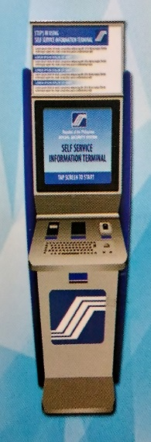
SELF-SERVICE INFORMATION TERMINAL (SSIT)
The SSS ‘kiosk’ allows access to SSS Application systems with the use of SS Card or UMID Card.

Slide 34
SSIT – Available Services
Online Inquiry :
  Contributions
  Loans
  Benefits
  ID information
Transactions :
  Salary loan
  Maternity Notification
  SSS Web registration
  Technical Retirement application
  Annual Confirmation of
  Pensioners (ACOP)
  Change of contact information
Reference to SSS Citizens Charter
Submit feedback and concerns

Slide 35
Self-service Facilities
SSIT
IVRS
(Interactive Voice
Response System)
Self-Service
Information
Terminals
917-7777
TEXT SSS & TEXT BLAST FACILITY
SSS WEBSITE
www.sss.gov.ph
PAYMENT
VIA GCash

Slide 36

ENHANCED TEXT-SSS
Enables SSS members to obtain membership information (contribution record, loan application status and loan balance) and to receive answers to text queries through mobile phone units.
(SERVICE WAS LAUNCHED IN FEB. 2010)
Notes:
36
36

Slide 37

Text blast facility (TBF)
TBF is A Short-Message Service (SMS) to provide SSS information to members and employers on their record and SSS announcements on new programs and projects.
Notes:
37

Slide 38
Self-service Facilities - Text-SSS
Available inquires :
  Contributions*
  Salary loans*
  Claim status*
  Submission of concerns or feedback
  Location of SSS branch offices
  Required documents
  *Requires registration and PIN
  Text fees 2.50 Globe & Smart, 2.00 Sun

Slide 39
Self-service Facilities
SSIT
IVRS
(Interactive Voice
Response System)
Self-Service
Information
Terminals
917-7777
TEXT SSS & TEXT BLAST FACILITY
SSS WEBSITE
www.sss.gov.ph
PAYMENT
VIA GCash

Slide 40
ENHANCED SSS WEBSITE
Aims to provide a secure, convenient access of information to SSS Members and Employers for viewing and printing their records, downloading forms and submitting applications/reports online.

Slide 41
SSS Web
Registered Members as of March 2016
TOTAL – 3,854,172

Slide 42
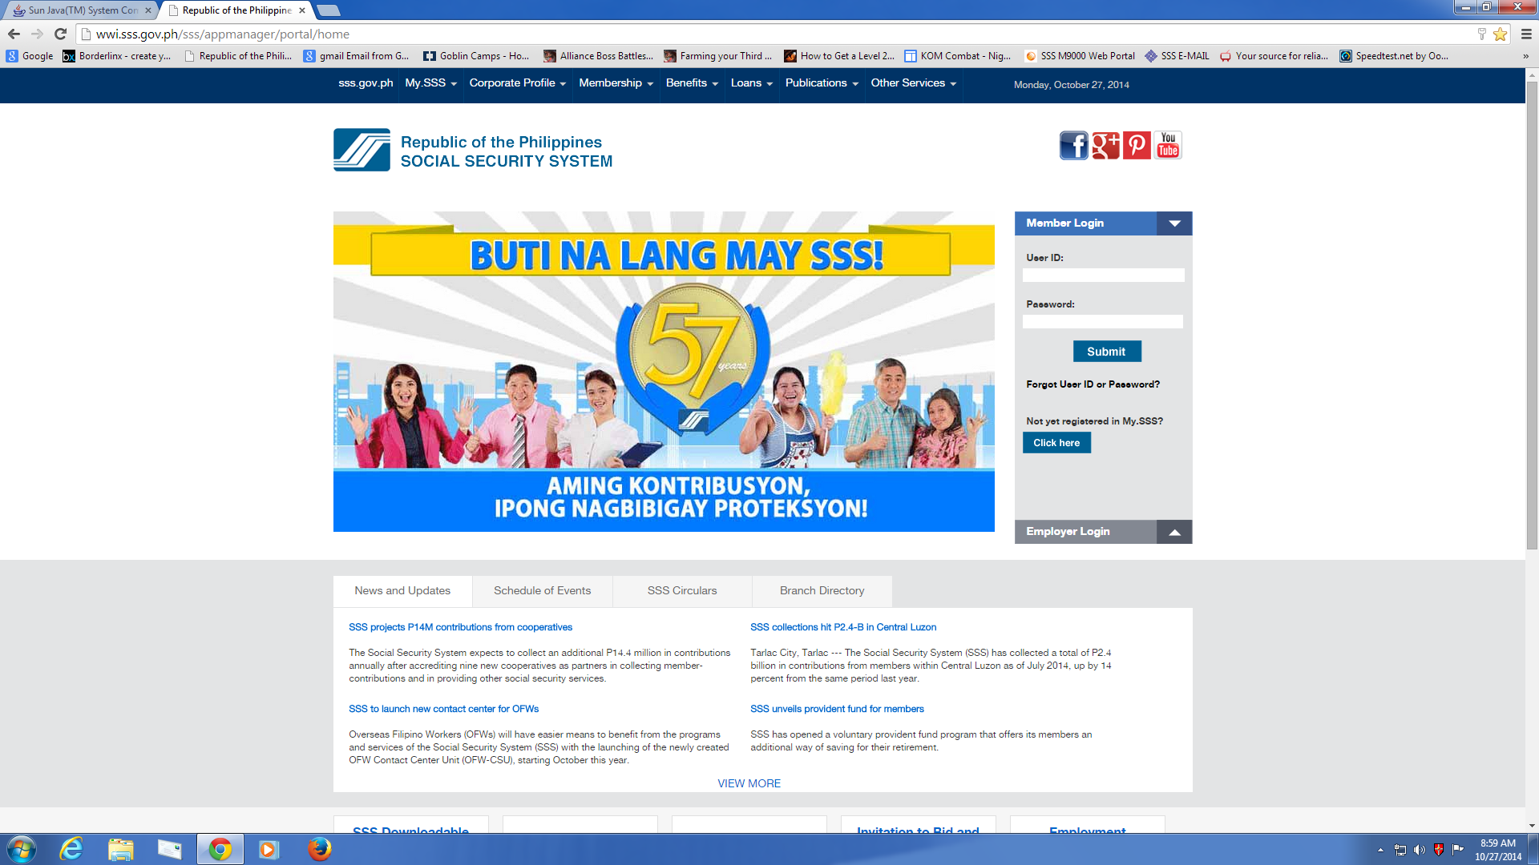
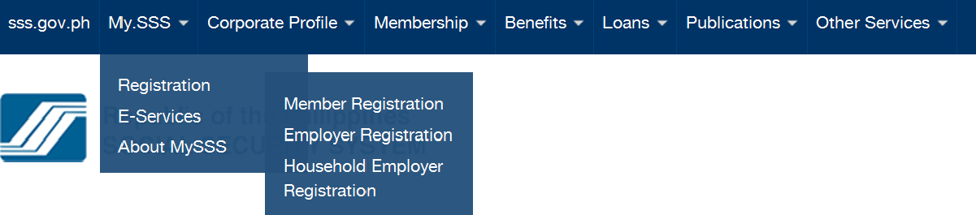
SSS Web – Inquiry & Transactions

Slide 43
SSS Web Services - Member
Online inquiry:
  Contributions
  Benefits
  Loans
  Eligibility inquiry to benefits & loans
  ID information
  Documentary requirements

Slide 44
SSS Web Services - Member
Online transactions :
  Submit Salary Loans
  Submit maternity notification
  Request for branch office appointment

Slide 45
SSS Web Services - Employer
Online inquiry:
  SSS Servicing Branch
  Contribution & Loan payments
  Sickness & Maternity claims
  Loans billing

Slide 46
SSS Web Services - Employer
Online transactions :
  Submit contribution collection list (R3)
  Submit loans collection list (ML2)
  Submit list of new employees (R1A)
  Submit maternity notification of employees
  Certify Salary Loan application of employees
  Submit sickness notification of employees

Slide 47
Self-service Facilities
SSIT
IVRS
(Interactive Voice
Response System)
Self-Service
Information
Terminals
917-7777
TEXT SSS & TEXT BLAST FACILITY
SSS WEBSITE
www.sss.gov.ph
PAYMENT
VIA GCash

Slide 48
6. Contribution and Loan Payments via GCash
GCash is an alternative payment facility for SS contribution and short and long-term loan amortization for Globe Telecom subscribed members.
Provide collection service to the SSS, which includes the following activities:
Electronic payment data entry and validation;
Confirmation of payment transaction;
Electronic generation, consolidation, validation and uploading of collection data to the SSS; and
Consolidation and monitoring of collection remittances
Notes:
48

Slide 49
Contact Information
For GCash related concerns:
739-2882 – landline (Globe) – NCR only
2882 – mobile phone (free of charge - Globe)
Email – www.globe.com.ph
SSS related concerns:
920-6446 to 55 – SSS hotline
180010CALLSSS (1800102255777) – SSS Toll Free number
Email – member_relations@sss.gov.ph
For SSS online transactions concerns, you may also contact us through contact information indicated below:
Email – onlineserviceassistance@sss.gov.ph
9206401 locals 5240,6066,6082,6447 and 6091 to 95

Slide 50


End of presentation. Thank you.

