Slide 1
EASE OF DOING BUSINESS WITH BIR
(presenter)

Slide 2
RATIONALE
Compliance to Administrative Order No. 38 last May 17 creating an inter-agency task force to initiate, implement, and monitor ease of doing business reforms

Slide 3
BIR’s initiatives…

Slide 4
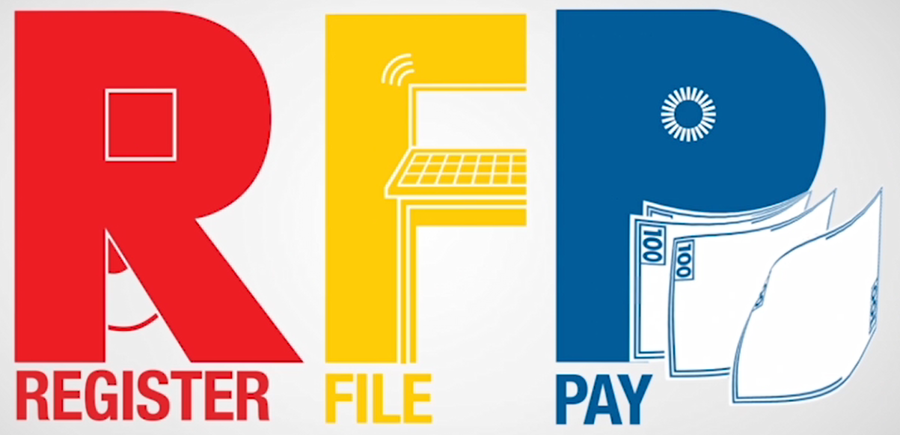

Slide 5
BIR eServices

Slide 6
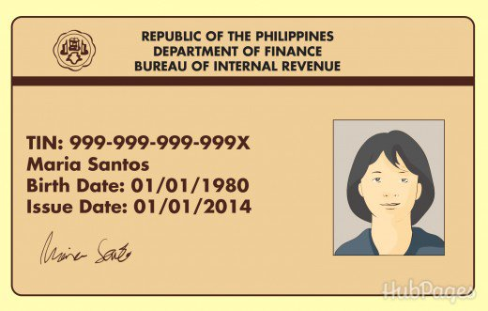
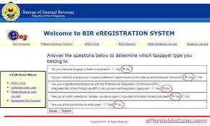
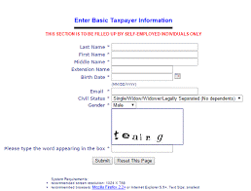
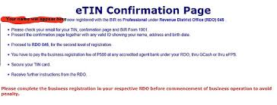
REGISTER (Primary)
OBTAIN TIN VIA…
manual…
Fill-up BIR Form
Go to BIR RDO & file (1day)
Secure TIN (within the day it was filed)
online…
Seclect eREG from the list of eServices
Access BIR website thru the internet
Fill-up online form & print confirmation page
Notes:
Obtain TIN thru manual process:
Fill up BIR form 1901/1902/1903/1904 (either obtain form from the RDO or any BIR office or download from BIR website)
Go to RDO (where place of residence or work is located) to file application
Get TIN card
Thru online process
Go to BIR website (discuss how to get to the eREG page, what icon to click)
Provide high level discussion on how eREG works until the eTIN confirmation page is displayed

Slide 7
The eRegistration System is a web application of various taxpayer registration services including TIN Issuance, Payment of Registration Fee and Generation of Certificate of Registration
Notes:
Please discuss main features of eREG system

Slide 8
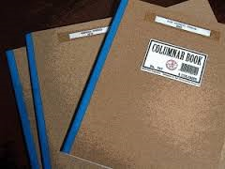
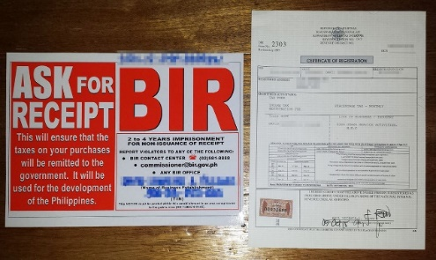
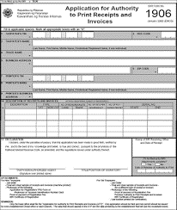
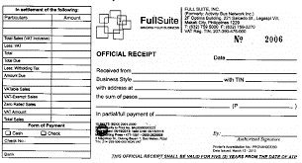
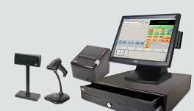
REGISTER (Secondary)
REGISTER BUSINESS
NSO Birth Certificate
Mayor’s Permit
DTI Certificate
PRC I.D.
Professional Tax Receipt
e-Payment facility of eFPS
Globe GCASH
BIR Authorized Agent Banks
Pay Business Registration Fee via the following BIR-accredited payment facilities
Go to BIR RDO & submit documentary requirements
Register Books of Accounts
(1 day)
Online accreditation, registration and use of CRM/POS machines
or
Secure COR
(I day)
Secure Authority to Print Receipts/Invoices
(1-7 days)
Notes:
Obtain TIN thru manual process:
Fill up BIR form 1901/1902/1903/1904 (either obtain form from the RDO or any BIR office or download from BIR website)
Go to RDO (where place of residence or work is located) to file application
Get TIN card
Thru online process
Go to BIR website (discuss how to get to the eREG page, what icon to click)
Provide high level discussion on how eREG works until the eTIN confirmation page is displayed

Slide 9
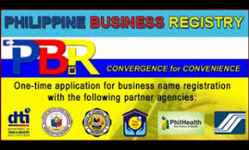
REGISTER
OBTAIN TIN FOR BUSINESS DIRECTLY THRU…
Department of Trade and Industry-Philippine Business Registry (DTI-PBR)
(for sole proprietors)
Securities and Exchange Commission
(for corporations and partnerships)
Notes:
Obtaining TIN thru DTI-PBR
Sole proprietors may go to Department of Trade and Industry (DTI) Offices with designated PBR Kiosks or tellers and register through them.
Kindly visit this website, http://www.business.gov.ph/web/guest/home, to know more on the DTI-Philippine Business Registry (PBR) system
Obtaining TIN thru the Securities and Exchange Commission (SEC)
In registering Corporations or Partnerships, TIN may be obtained directly from SEC (pre-generated TINs)

Slide 10
The Philippine Business Registry (pbr) is a government-initiated project that facilitates business registration-related transactions by integrating all agencies involved in business registration, such as the Department of Trade And Industry (DTI), Securities and Exchange Commission (SEC), Cooperative Development Authority (CDA), Bureau of Internal Revenue (BIR), Social Security System (SSS), Home Development Mutual Fund (PAG-IBIG), Philippine Health Insurance Corporation (Philhealth), Local Government Units (LGUs) and other permit/license-issuing agencies. It provides a faster process for business registration, thus strengthening the government’s effort of providing quality service to the people and realizing its commitment to curb corruption and reduce red tape in the bureaucracy.
In particular, it is a web-based system that serves as a one-stop shop for entrepreneurs who need to transact with several agencies to be able to start operating a business. each of the agencies’ computerized registration systems will be interlinked so that applicants need not physically go to each agency to register their businesses.

Slide 11
eAccReg is an online accreditation, registration and use of CRM/POS machines and/or other business machines generating receipts/invoices.

Slide 12
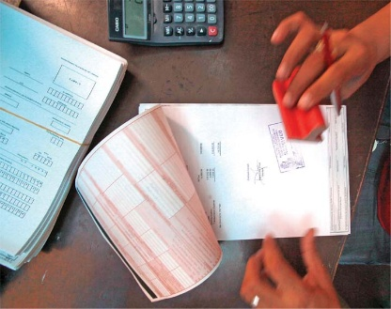
FILE
manual…
Accomplish BIR form
Submit to RDO
Notes:
Manual process of filing a return

Slide 13
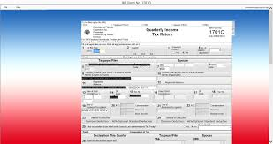
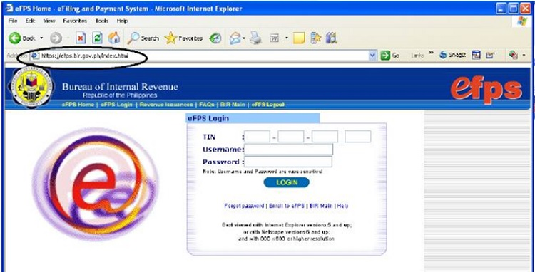
FILE
online…
Notes:
BIR has 2 major online filing facilities – eFPS and eBIRForms

Slide 14
An e-service from the Bureau of Internal Revenue that gives taxpayers a paperless tax filing experience and convenient payment of tax dues utilizing the power of the Internet

Slide 15
eFPS
MANDATED TO FILE & PAY | ISSUANCE
Tax Account Management Program (TAMP Taxpayers) | RR No. 10-2014
Accredited Importers and Prospective Importers required to Secure BIR ICC and BIR BCC | RR No. 10-2014
National Government Agencies | RR No. 1-2013
All licensed local contractors / Government Bidders | RR No. 10-2012
Enterprises enjoying Fiscal Incentives (PEZA, BOI, Various Zone Authorities, Etc.) | RR No. 1-2010
Top 5,000 Individual Taxpayers | RR No. 6-2009
Corporations with Paid Up Capital Stock of 10 Million and above | RR No. 10-2007
Corporations with complete Computerized System | RR No. 10-2007
Procuring Government Agencies with respect to Withholding of VAT and Percentage Taxes | RR No. 3-2005
Large Taxpayers | RR No. 2-2002 as amended
Top 20,000 Corporations | RR No. 2-98 as amended
Notes:
List of taxpayers mandated to file using the eFPS and the corresponding issuances

Slide 16
The Electronic Bureau of Internal Revenue Forms (eBIRForms) was developed primarily to provide taxpayers with an alternative mode of preparing and filing tax returns that is easier and more convenient.

Slide 17
ebirforms
MANDATED TO FILE & PAY | ISSUANCE
Accredited Tax Agents / Tax Practitioners and All its Client Taxpayers | RR No. 6-2014
Accredited Printers and Supplemental Receipts/ Invoices | RR No. 6-2014
One Time Transactions (ONETT) Taxpayers | RR No. 6-2014
Those who shall file with "No Payment“ | RR No. 6-2014
Government Owned or Controlled Corporations | RR No. 6-2014
Local Government Units except Barangays | RR No. 6-2014
Cooperatives registered with National Electrification Administration (NEA) and Local Water Utilities Administration (LWUA) | RR No. 6-2014
Notes:
List of taxpayers mandated to file using the eBIRForms and the corresponding issuances

Slide 18
DECLARATION
Enable the taxpayer to submit their Monthly Alphalist of Payees(MAP) and Summary Alphalist of Withholding Tax(SAWT), Summary List of Sales, Purchases and Importations(SLSPI) attachments electronically via e-mail/web facility

Slide 19
DECLARATION
Process of reporting the gross monthly sales of taxpayers engaged in business using Cash Register Machine (CRM), Point of Sale (POS) System and Other Sales Machines (OSM) or any other similar devices through different channels.

Slide 20
PAY
For …
users
e-Payment facility of eFPS
users
Globe GCASH
Manual filers
BIR Authorized Agent Banks

Slide 21
LIST OF EFPS ACCREDITED BANKS
Notes:
Here is the list of eFPS-Accredited Agent Banks. It includes both government banks (DBP, LBP) and private commercial banks.

Slide 22
Other BIR eServices
The Electronic Documentary Stamp Tax (eDST) System is a web-based system that allows taxpayers to imprint/affix secured documentary stamps on taxable documents.

Slide 23
Other BIR eServices
Download the payment confirmation reflecting your mobile payment of taxes and/or annual business registration fee.

Slide 24
www.bir.gov.ph
BIR Contact Center: (02) 981-8888

